Slide 1


14 May 2021
Radford Burger

Slide 2



Slide 3
What do we already know?
Let’s look at our previous Gui application
Polymorphism
  with inheritance (Employee example)
  What is polymorphism?
  Abstract and concrete classes

Slide 4






What do we already know ?
Inheritance is a mechanism that allows one class to inherit properties or behaviors from another class.
The parent class is called the superclass, and the derived class is called the subclass.
Subclasses are linked to superclasses using the extends keyword during their definition.
a child class has IS-A relationship with the parent class.
A superclass can have any number of subclasses. But a subclass can have only one superclass
A subclass does not inherit the private members of its parent class.
Subclasses can define new local methods or fields to use, or can use the super keyword to call inherited methods or the super constructor

Slide 5
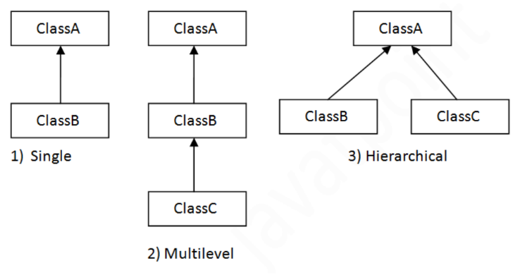

What do we already know ?
Multiple classes can inherit from the same parent class, forming a tree-like hierarchy structure

Slide 6

Inheritance is one of the most important aspects of Object Oriented Programming (OOP). The key to understanding Inheritance is that it provides code re-usability.
LottoGui

Slide 7

Employee example
Occurs when there are one or more classes or objects related to each other by inheritance.
Ability of inherited methods to perform different tasks.
This was an example of dynamic polymorphism

Slide 8
Dynamic polymorphism: In the case where a reference variable is calling an overridden method, the method to be invoked is determined by the object your reference variable is pointing to.
Polymorphism ensures that the proper method will be executed based on the calling object’s type.
This relates to method overriding: the mechanism by which multiple methods can be defined with same name and signature in the superclass and subclass.

Slide 9

A concrete class is a complete class with all methods defined fully.
Objects can be instantiated from the class.
An abstract class is declared using “abstract” keyword.
An abstract class can contain abstract as well as regular (concrete) methods.
It cannot be used to create objects.
If a child does not implement all the abstract methods of abstract parent class, then the child class must be declared abstract as well.

Slide 10

<abstract>
Employee
-abstract pay()
Hourly
-pay()
Salaried
-pay()
Supplier
-pay()
What happens if we have another class called Supplier?
A supplier has a name and also needs to be paid.

